Slide 1
MiLAN: Middleware to Support Sensor Network Applications
Jonghak Kim, Da Huo, Hyungik Oh
Notes:
Now, I’ll present MiLAN. MiLAN is a middleware. Given network condition and sensors with limited energy, it can maximize application lifetime while providing required application QoS. To achieve these goals, MiLAN controls network as well as sensors themselves considering the characteristics of sensor networks.
Authors are from university of Rochester and this work is published in IEEE Network Magazine.
발표할 MiLAN이 간단하게 설명.
Sensor network이 이러저러한 불안정하고 제한적인 특성들을 고려해서 어떻게 하면 어플리케이션이 요구하는 QoS 수준의 데이터들을 application에게 제공할 수 있을 것인가? 그런데 이 일을 application에 다 하게 하면 어플리케이션 개발자가 힘드니까 개발 비용을 줄이기 위해서 middleware에서 다 해주고 어플리케이션 개발자는 그 middleware를 이용하면 쉽게 어플리케이션을 짤 수 있도록 해 주자.

Slide 2
One Line Comment
MiLAN is a middleware which goal is 1)maximizing application lifetime while 2)providing application QoS by controlling and optimizing network as well as sensors
Notes:
MiLAN is blah~ blah~

Slide 3



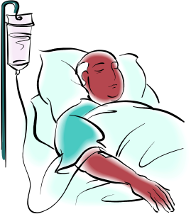

Motivation
Personal Health Monitor Application
  The QoS of the different variables of interest at each different states of patient
  The state-based Variable Requirement graph
Low blood pressure
High respiratory rate
Blood
Pressure
0.8
Respiratory
Rate
0.8
Blood O2
0.3
Blood O2
0.7
0.8
Heart
Rate
Heart
Rate
0.3
0.3
Blood
O2
1.0
ECG
Diagram
0.3
Normal Heart Rate
High Heart Rate
Blood
Pressure
Notes:
MiLAN is designed for personal health monitor application. Therefore, to help you understand MiLAN, I should explain about personal health monitor application. In personal health monitor application, there is a QoS of the different variables of interest at each different states of patient. For example, when patient in a state of low blood pressure, doctor may want to check blood pressure and oxygen status in blood with reasonable reliability. In this case, blood pressure should have at least 0.8 reliability and blood o2 should have 0.7 reliability. Let’s see another example, when a patient in a normal heart rate, doctor only want to know heart rate with 0.3 reliability, but when patient in a high heart rate, doctor should check more variables than normal state, so doctor should check heart rate with 0.8 reliability and Bood O2 with 0.3 reliability and ECG Diagram with 1.0 and Blood pressure with 0.3 reliability.
All these information is application specific information and this may be given by medical doctors. And we call this information the state-based variable requirement graph
Medical application을 설명한다. 환자의 state마다 필요로 하는 variable의 reliability가 달라도 된다는 것과 해당 reliability의 variable 값을 얻기 위해서는 어떤 sensor로부터 data를 얻어야 한다는 것 등의 application scenario를 설명해야 한다.

Slide 4
Motivation
Personal Health Monitor Application
  The QoS of the different variables depends on which sensors provide data to the application
  The Sensor QoS Graph
Blood
pressure
Heart
rate
1.0
0.7
1.0
0.8
0.7
1.0
0.7
0.8
0.7
Blood
pulse
Blood
press
Blood
flow
Pulse
oxy
ECG
Blood
press
Blood
flow
Pulse
oxy
Virtual sensor
Notes:
One thing you should know is that when you want to get a value of each variables, there are multiple candidate sensors for that variable. For example, when the value of blood pressure is required, one can get a value from sensor of blood pulse, blood pressure, blood flow and pulse oxygen, but each sensor provide different reliability for that variable. In case of blood pressure sensor can provide the reliability of 1.0 for blood pressure variable, but blood pulse sensor can provide 0.7 reliability for blood pressure variable. And a combination of sensors also can provide variable value with some reliability. We call this combination of sensors virtual sensor. For example, for heart rate variable, the combination of blood pulse and blood pulse sensors can provide 1.0 reliability for heart rate variable.
Until now, I explained about personal health monitor application which wants a set of variables with some specific reliability for each variables at each different states of patient. MiLAN can fulfill given QoS requirement.
이러이러해서…
주어진 환자의 상태가 있으면 그것을 바탕으로 어떤 sensor들로부터 data를 받으면 어플리케이션이 요구하는 reliability의 data를 수집할 수 있는지를 알 수 있다. 즉, application feasible sensor set을 구할 수 있다.

Slide 5
Motivation
The characteristics of sensor network
1. Inherent Distribution
The sensors are distributed throughout a physical space and primarily connected wirelessly
2. Dynamic Availability
Either mobility through space, addition of new sensors, or loss of existing sensors causes the set of available sensors to change over time
3. Resource Limitation
Both network bandwidth and sensor energy are constrained. This is especially true when considering battery-powered sensors and wireless networks
Notes:
MiLAN try to provide QoS requirement given by application, but it’s not easy because of several challenging characteristics of sensor network. First, sensor network is inherently distributed. As you know, the sensors are distributed throughout a physical space and primarily connected wirelessly. This characteristic increase unreliability of whole system. Second, sensor network has dynamic availability. Either mobility through space, addition of new sensors, or loss of existing sensors causes the set of available sensors to change over time. Lastly, sensor network has resource limitation. Both network bandwidth and sensor energy are constrained. As you know sensors are powered by battery and generally sensor networks are connected with wireless network, but it can provide less bandwidth and less reliable connectivity than wired network.
Considering these challenging characteristics of sensor network, MiLAN try to provide application QoS and maximize application lifetime.

Slide 6
Goal of MiLAN
Goal
  To satisfy the given application QoS specification and provide data to application as long as possible, MiLAN control sensor network as well as the sensors
Application
QoS
Requirement
Network
Monitoring
State Of
Monitored
Objects
Control the network as well as the sensors
Provide
Application
QoS
Maximize
Application
Lifetime
Notes:
Then, what is the goal of MiLAN. The goal of MiLAN is to blah~
Given network condition and state of monitored objects, namely patient, MiLAN can maximize application lifetime while providing application QoS. For that MiLAN control the network and sensors. From now on, I’ll explain about MiLAN in more detail.
밀란의 실체 공개!!!
MiLAN에서 제공해 주는 것은 무엇인가?
MiLAN은 개별 sensor들에 대한 full-control을 가지고 있다. 즉, sensor를 껐다 켰다 할 수 있다.
MiLAN은 어떻게 하면 energy-constrained, 분산되어 있고, network에 붙었다 떨어졌다 하고, wireless network을 사용함으로써 bandwidth가 제한적인 sensor들을 control해서 사용자가 원하는 최소한의 QoS 이상은 만족하면서 가능한 오랫동안 data를 sensor network으로부터 제공받을 수 있도록 application을 도와준다. 쓸데 없이 많은 sensor들을 이용하지 않고, 최소한의 QoS를 맞춰줄 수 없을 만큼 적은 양의 센서를 이용하지도 않는다. 딱 맞게 센서를 사용한다. Sensor는 여러 가지 이유로 아껴 써야 하는 자원이다. 그리고 data의 routing path도 MiLAN이 control해 준다.
Sensor on&off 및 data routing path를 정한 후에 그것이 실제로 network 상에 어떻게 수행되게 할 것이냐? 구체적인 mechanism이 뭐냐?

Slide 7
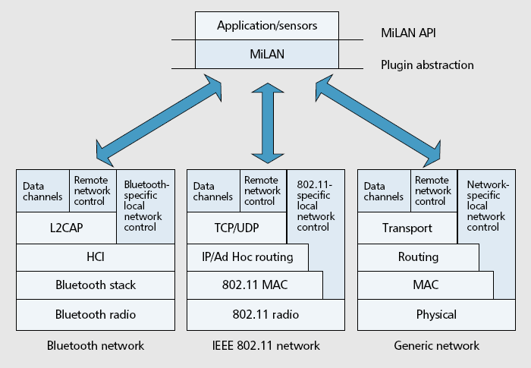
MiLAN Components
Notes:
MiLAN presents an API through which the application represents its requirements with regard to different sensors that may be available. MiLAN also presents an abstraction from the network-level functionality through which it issues commands to determine available sensors and configure the network.

Slide 8

MiLAN Overview
Application
Middleware - MiLAN
Application
QoS Requirement
App.
Feasible
Set
Network
Feasible
Set
Network
Information
Sensed Object
States
Overall
Set
Trade-off computation
Application Logic
Doctor
Sensor
Reading
Sensor Network Configuration
Sensor Network
Notes:
This is overview of MiLAN. Medical doctor will specify application QoS Requirement and this information will be provide to MiLAN. MiLAN will calculate the application feasible set with both application QoS requirement and sensed object states. This process result in the set required for doctor who want to check the patient in the specific state. And MiLAN will measure network information. This information include the set of available sensors and available bandwidth among each sensors. With both application feasible set and network feasible set, overall set is calculated. Overall set is the union of application feasible set and network feasible set. With overall set, MiLAN calculate the final sensor set which can provide maximum application life time. Then, with this information MiLAN configure sensor network properly.

Slide 9
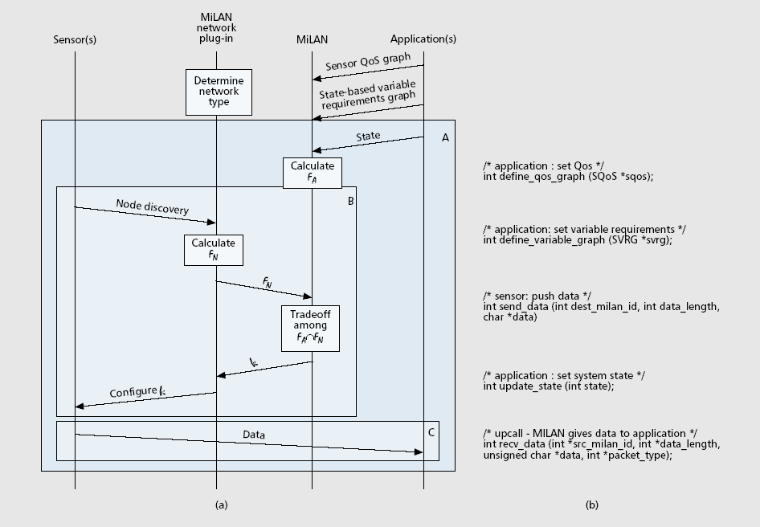
A High-level overview of MiLAN operation and Partial MiLAN API
Notes:
Applications represent their Sensor QoS graph to MiLAN using the SQoS structure and the define_qos_graph function, and they represent their State-based Variable Requirements graph to MiLAN using the SVRG structure and the define_variable_graph function. After initialization, sensors send data to the application using the send data function and applications receive the data from MiLAN via an upcall from the recv_data function. Applications specify to MiLAN that they have changed state through the update_state function

Slide 10
Application Feasible Set F_{A}
Multiple set of sensors, which can provide application QoS at a given state, can be derived from the state-based variable requirement graph and the sensor QoS graph
A patient state
  medium stress
  high heart rate, normal respiratory rate, and low blood pressure
Set # | Sensors
1 | Blood flow, Respiratory rate
2 | Blood flow, ECG (3 leads)
3 | Pulse oxymeter, Blood pressure, ECG(1 lead), Respiratory rate
4 | Pulse oxymeter, Blood pressure, ECG(3 leads)
5 | Oxygen Measurement, Blood pressure, ECG(1 lead), Respiratory rate
6 | Oxygen measurement, Blood pressure, ECG(3 leads)
Notes:
This application feasible set FA. Given patient state, from the state-based variable requirement we can determine this application feasible set. For example, patient are medium stress and high heart rate, normal respiratory rate, and low blood pressure. We can get this information. All these are candidate set for monitoring patient in a specific state. Among these sets, MiLAN will choose one, which will provide best performance.

Slide 11
Network Feasible Set F_{N}
Network Feasible Set
  Network plugin’s job
  The subsets of nodes that can be supported by the network
    Suppose that the sensors and processors communicate using an IEEE 802.11a network
    It can support overall throughput of nearly 11Mb/s
    However, if multiple applications are running simultaneously on the network and the personal health monitor application can only utilize 100kb/s of the throughput, the network would not be able to support the transmission of data from the ECG sensor with either 3, 5, or 12 leads
Notes:
Network feasible set is the subsets of nodes that can be supported by the network. And this information is provided by network plugin. Since network status are changed frequently, network feasible set would be changed. For example, even though IEEE 802.11a network can provide nearly 11Mb/s network bandwidth, but if multiple applications are running simultaneously on the network, personal health monitor application may be provided with partial bandwidth like 100kb/s of the maximum bandwidth. So, in this case, network would not be able to support the transmission of data from the ECG sensor with either 3, 5, 12 leads

Slide 12
Overall Set F
F = F_{A} ∩ F_{N}
Example of Overall set F
  Suppose network can’t support ECG 3, 5 12 leads, since other applications are running simultaneously
Set # | Sensors
1 | Blood flow, Respiratory rate
2 | Blood flow, ECG (3 leads)
3 | Pulse oxymeter, Blood pressure, ECG(1 lead), Respiratory rate
4 | Pulse oxymeter, Blood pressure, ECG(3 leads)
5 | Oxygen Measurement, Blood pressure, ECG(1 lead), Respiratory rate
6 | Oxygen measurement, Blood pressure, ECG(3 leads)
Set # | Sensors
1 | Blood flow, Respiratory rate
3 | Pulse oxymeter, Blood pressure, ECG(1 lead), Respiratory rate
5 | Oxygen Measurement, Blood pressure, ECG(1 lead), Respiratory rate
F_{A} ∩ F_{N}
Overall Set F
Application Feasible Set F_{A}
Notes:
Overall set is the union of application feasible set and network feasible set. If we follow the network state given in the previous slide, ECG with 3, 5, 12 leads can not be supported. Therefore, we can get overall set F excluding set number 2, 4, 6.
F가 정해지면 각 sensor를 어떻게 control하나? 즉, 어떻게 on-off 시키는가? 어떤 mechanism으로?

Slide 13
Trade-off Computation
Goal
  Among the elements in overall set F, MiLAN choose an element f that represents the best performance/cost trade-off
For getting more information about trade-off computation, refer to the paper named “Providing Application QoS through Intelligent Sensor Management” published in Elsevier Ad Hoc Network Journal, vol. 1, no. 2-3, 2003
  Mathematically formulate the problem
  Interpret the problem as a Generalized Maximum Flow Problem
  None of the algorithms that are commonly used to solve generalized maximum flow problem in polynomial time can be used for the sensor scheduling problem
  They use simple linear programming approach
Notes:
Then MiLAN perform trade-off computation. The goal of trade-off computation is choose an element that represents the best performance/cost trade-off among the elements in overall set F. At this point, “best” means what? The element that can provide best performance is the set which can provide maximum application lifetime.
In the paper, author didn’t mention it in detail. To get more information about it, I should read the paper named blah~. In this paper, they mathematically formulate this problem and transform this problem into generalized maximum flow problem. Generalized maximum flow problem is blah~ But they didn’t discuss about detail solution. They just say that you refer to the paper which present the solution for generalized maximum flow problem. Since I think that this is beyond this presentation, I don’t explain it more.

Slide 14
The END
Thank you

